Slide 1

Leetcode Java Debug Enhancer - Streamlined Debugging for Algorithm Problems
Welcome to our presentation on a novel Java-based debugging enhancer tailored for Leetcode algorithm problems. This tool streamlines debugging, handles I/O, and improves logging, simplifying the process of tackling challenging algorithms. Join us as we delve into its key features and implementation.

Slide 2
Debugging Leetcode Problems: The Challenges
Complex Logic
Input/Output Handling
Limited Debugging Tools
Leetcode algorithms often involve intricate logic and data structures, making debugging a time-consuming endeavor.
Handling diverse input formats and generating desired outputs effectively can pose a significant challenge.
Traditional debugging tools lack the specific features needed for effectively analyzing algorithms and their runtime behavior.

Slide 3

Objectives: Streamlining the Debugging Process
1
Streamline Debugging
2
Efficient I/O Handling
3
Enhanced Logging and Printing
Our enhancer aims to simplify the debugging process by providing intuitive tools and features.
We prioritize seamless input and output handling, supporting diverse formats for ease of use.
Our tool offers comprehensive logging and printing strategies to provide detailed diagnostics.

Slide 4
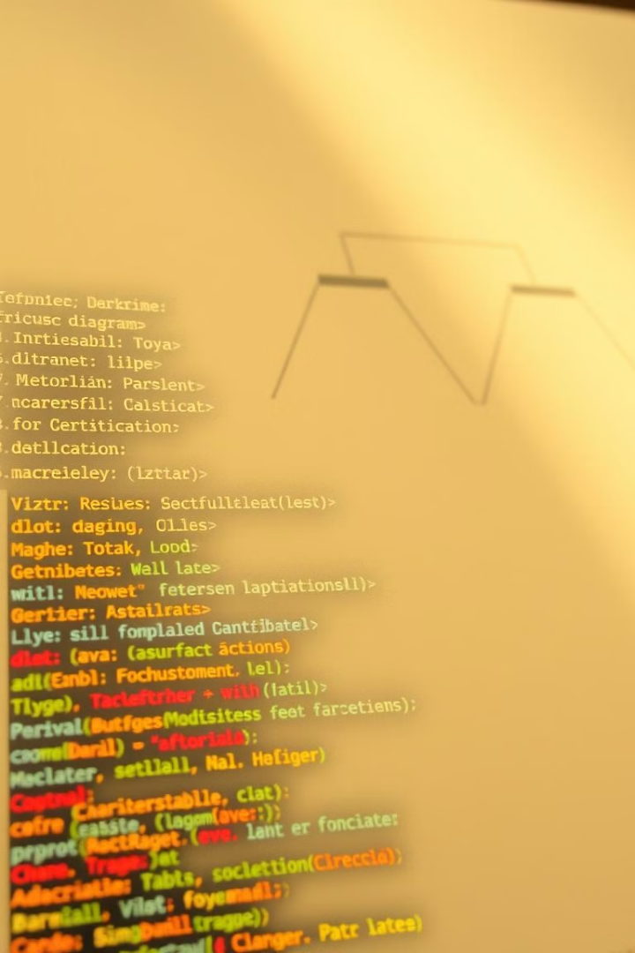
Solution Overview: Java-based Debugging Enhancer
We present a Java-based debugging enhancer specifically designed to address the challenges of debugging Leetcode algorithms. Our solution leverages key Java features and libraries for an optimal debugging experience.

Slide 5
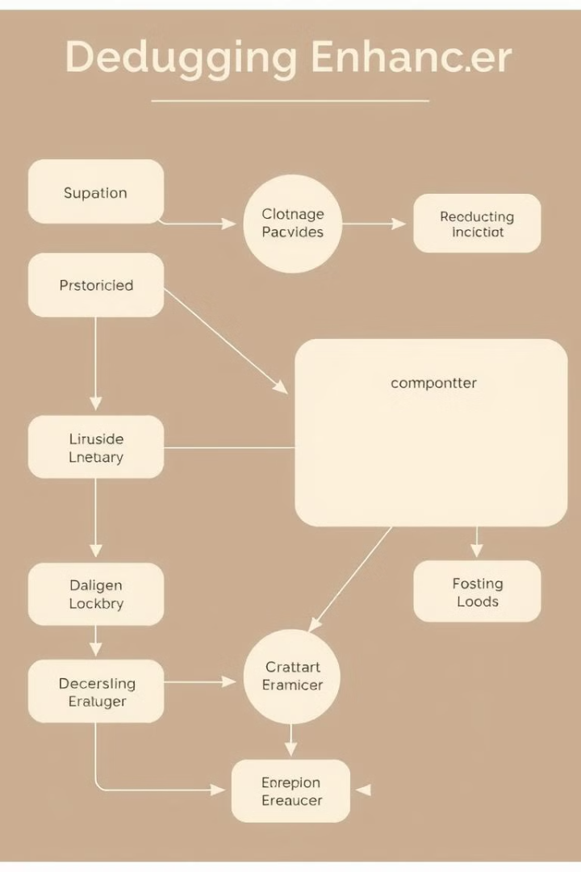
Architecture: Key Components
EnhancerProcessor
InputHandler
The core component responsible for processing input, executing algorithms, and generating outputs.
Handles parsing and validating input data from various sources, ensuring compatibility with algorithm requirements.
OutputFormatter
Logger
Formats the output data generated by the algorithms into user-friendly and readable formats.
Captures detailed logs of execution steps, function calls, and internal states for in-depth analysis.

Slide 6




Input/Output Customization: Flexible Configuration
Config Files
Annotations
Command-Line Interface
Our enhancer supports customizable configuration files for defining input formats, output styles, and logging levels.
Users can annotate their code with special tags to specify input/output parameters and desired formatting options.
A command-line interface allows users to easily modify settings and run algorithms with specific configurations.

Slide 7
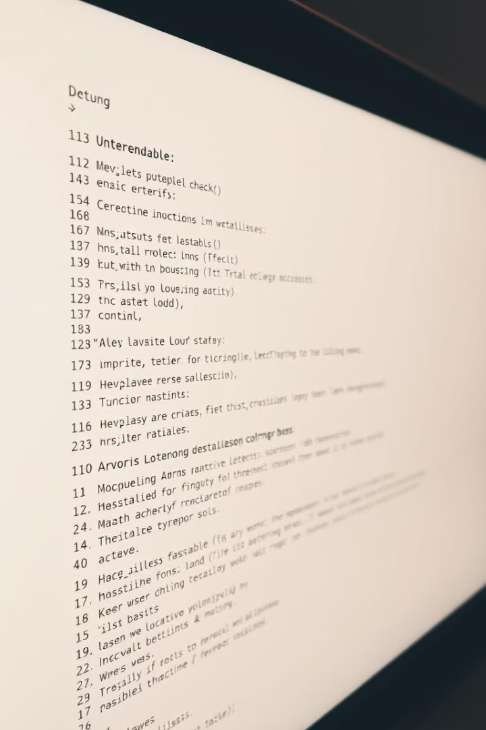
Logging and Printing Strategies: Comprehensive Diagnostics
1
Step-by-Step Logging
Log every step of the algorithm's execution, including variable values, function calls, and control flow transitions.
2
Conditional Logging
Enable logging for specific code sections or conditions to focus on areas of interest and pinpoint potential issues.
3
Customizable Output Formats
Output data in various formats like plain text, JSON, or XML, depending on user preferences and analysis needs.

Slide 8




Addressing Implementation Challenges
Performance Optimization
Balancing logging and performance is crucial to avoid slowing down algorithm execution.
Error Handling and Exception Management
Implementing robust error handling mechanisms to gracefully handle unexpected input or algorithm exceptions.
Code Maintainability and Extensibility
Ensuring the codebase is well-structured and extensible for future enhancements and algorithm updates.

Slide 9



Testing and Validation Methodologies
Unit Testing
1
Thorough testing of individual components like InputHandler and OutputFormatter.
Integration Testing
2
Validating the integration of different components, ensuring seamless interaction between modules.
End-to-End Testing
3
Testing the entire system from input to output, simulating real-world usage scenarios.

Slide 10
Achievements and Future Enhancements
Improved Debugging Efficiency
1
Significantly reduced debugging time and effort for Leetcode algorithm problems.
Enhanced Code Clarity and Understandability
2
Improved code maintainability and readability through detailed logging and printing strategies.
Expanded Feature Set
3
Plans for future enhancements include adding features like visualization tools and dynamic analysis.

